Slide 1
WORLD MUSIC

Slide 2
What is world music?
A non-western music
A term often used to describe a large and varied collection of music and musicians.

Slide 3
Korea
Located at the crossroads of Northeast Asia. Lies between Japan, the Russian Far East and China.
Capital city: Seoul
Currency: Won
Language: Korean
Major cities in Korea: Seoul (10.1 mil), Busan (3.5mil), Incheon (2.6 mil) etc.
Population: 48.46 million (2007)

Slide 4
Forms of Korean music
Religious/Shamanistic
Folk
Court Music

Slide 5
Introduction to Korean folk music
Korean folk music is varied and complex, but it is generally strongly rhythmic, simple and bright.
Korea's folk music tradition, with its generous use of bright rhythms and melodies, offers a more energetic and capricious contrast to the nation's collection of classical music works.
Folk music represents the soul and sound of traditional Korean villages with an eclectic array of music forms including numerous folk songs, various forms of instrumental pieces, pansori, and shaman ritual music.

Slide 6
Types of folk music
Sanjo
Sinawi
Pansori
Chapga
Folk Songs
Pungmulnori & Samullori
Shaman Ritual Music

Slide 7
Introduction to Folk songs
Koreans are known for their natural singing ability, their nation cultivated a large collection of folk songs.
These songs are normally classified according to five regions of the nation: northwestern region, Seoul & Kyonggi Province, eastern region, southern region, Cheju Island. Each region has its own collection of songs and vocal styles which are quite distinctive. Each region also bases its songs on a slightly different melodic scale.
There are a number of folk songs common to all regions of Korea although they might exist in slightly different variations.
Some of the common folk songs are Arirang, Miryang Arirang, Doraji-Taryong, Banga-Taryong, Kangwondo-Arirang, Nongbuga, Yukjabaegi, Susimga, and Cheonan-Samgeori.
There are also collections of folk songs associated with various activities, such as: farm songs, fishing songs, work songs, ceremonial songs, marriage songs, and children's songs

Slide 8
About Arirang
Arirang has been regarded as the representative of Korean folk songs, together with its name, form, rhythm, and its vitality as a folk song.
One of the few Korean folk songs that Koreans can sing, it is also well-known among foreigners.
In the olden days Koreans were very good at swallowing their anger and sorrow. Sounds coming out from the deepest heart of Koreans resembled the Arirang. Arirang is a frank confession of love as well as regret at parting. The passionate feelings were shared also by our forefathers. It is Arirang that spreads out passionate love as if a silk cloth.
There are more than one hundred different Arirangs in Korea, but the words of every Arirang are simple in phrasing. Their characteristic is that although the name is one and the same, words and melodies differ from one region to another.

Slide 9
Origin of Arirang
It is hard to know exactly when and where Arirang came out and spread.
It is presumed that its name, melody, and refrain formed Arirang as a migrating folk song after long years of in dwelling in people's sphere of life.
The period when Arirang emerged, was the nineteenth century when people began to experience the realities of the modern age.

Slide 10
Arirang Song/Music
Genre: Folk music
The basic form of Arirang consists of three beats and its poetic lines are two.
Syllables vary in many ways in the three beats of rhythm and the beats themselves can vary. But the poetic lines are fixed into two.
Beat: ¾

Slide 11
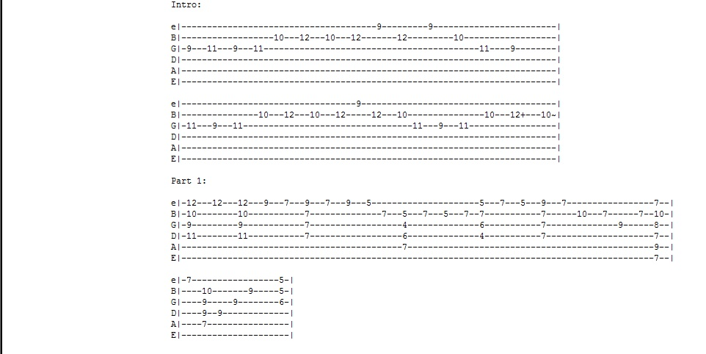
Arirang guitar tab part 1

Slide 12
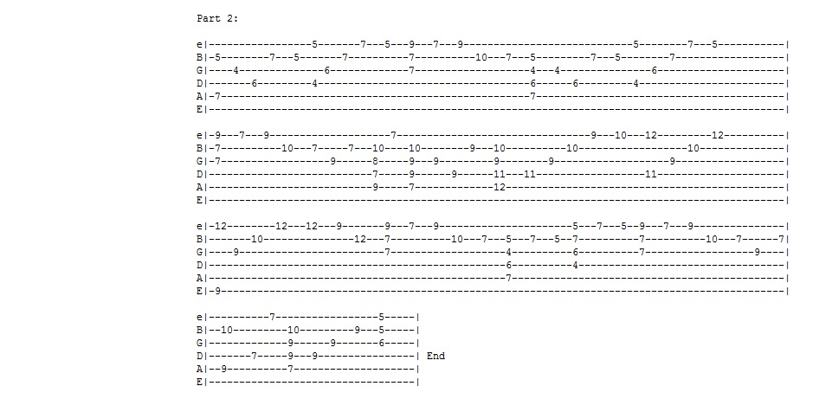
Arirang guitar tab part 2

Slide 13
Bibliography
"World Of Music." What Is World Music? Web. 27 Apr. 2012. <http://www.superniche.org/what-is-world-music>.
WELCOME! JEONGSEON ARIRANG SCHOOL. Web. 27 Apr. 2012. <http://arirangschool.com/about.html>.
"Traditional Korean Music Pages." Angelfire.com. Web. 15 May 2012. <http://www.angelfire.com/alt/koreanmusic/index.html>.

